Slide 1
COVID-19 Outbreak: Communications Toolkit For Congregate Living Environments
Developed in Collaboration with Trillium Health Partners, William Osler Health System, Markham Stouffville Hospital, Royal Victoria Regional Health Centre and Ontario Health Central Region
May 2020

Slide 2
Outline
This communications toolkit consists of the following information to support in the event of a COVID-19 outbreak or death(s):
Process and Notifications
Web Updates
Media Relations
PHIPA Guidance
Key Messages
Examples and Additional Resources

Slide 3
Process and Notifications

Slide 4
Communications Cascade: Outbreak Declared *Suggested order of stakeholder engagement
STAKEHOLDERS | TACTICS | RESPONSIBLE
Public Health | Contact Public Health unit to notify regarding outbreak | Congregate Living Home
Affected unit | Key messages for team huddle | Congregate Living Home
All staff and professional staff | All user memo Update to Intranet (for options, please refer to Web Updates section of this slide deck) Signage | Congregate Living Home
Residents/Patients/Families | Resident/Patient notification | Congregate Living Home
Elected officials notification (as required) | Email notification | Public Health Unit or Congregate Living Home
Public | Website update (for options, please refer to Web Updates section of this slide deck) | Public Health Unit or Congregate Living Home
Media (as required) | Reactive media statement (if required) | Public Health Unit or Congregate Living Home
Please note: Recommendation is that stakeholders outlined here should be engaged in the order of the cascade an hour apart from each other. The intention is to disclose in a timely manner, started with communicating to those impact most, first and leader led.

Slide 5
Communications Cascade: Outbreak Declared Over *Suggested order of stakeholder engagement
STAKEHOLDERS | TACTICS | RESPONSIBLE
Public Health | Contact Public Health unit to notify regarding outbreak | Congregate Living Home
Affected unit | Key messages for team huddle | Congregate Living Home
All staff and professional staff | All user memo Update to Intranet (for options, please refer to Web Updates section of this slide deck) Signage | Congregate Living Home
Residents/Patients/Families | Resident/Patient notification | Congregate Living Home
Elected officials notification (as required) | Email notification | Public Health Unit or Congregate Living Home
Public | Website update (for options, please refer to Web Updates section of this slide deck) | Public Health Unit or Congregate Living Home
Media (as required) | Reactive media statement (if required) | Public Health Unit or Congregate Living Home
Please note: Recommendation is that stakeholders outlined here should be engaged in the order of the cascade an hour apart from each other. The intention is to disclose in a timely manner, started with communicating to those impact most, first and leader led.

Slide 6
Communications Cascade: Patient/Resident Death(s) Due to Outbreak *Suggested order of stakeholder engagement
STAKEHOLDERS | TACTICS | RESPONSIBLE
Family of individual who passed away | Family notification, as per usual process | Congregate Living Home
Senior Leadership Team | Email - Notify of case and announcement to staff and public. | Congregate Living Home
Team (managing issue) | Huddle - Go over rollout to ensure alignment with leadership, affected unit/department | Congregate Living Home
Public Health | Formal notification | Congregate Living Home
Unit/department of individual who passed away | Huddle (while practicing physical distancing) - Program leadership to offer Employee and Family Assistance Program support (have Employee Health presence available) | Congregate Living Home
All staff and professional staff | Include a COVID-19 tracker section in a Weekly COVID-19 Bulletin (sent by email) that can provide staff with Total # of individuals with COVID-19 Total # of staff with COVID-19 Total # of deaths due to COVID-19 | Congregate Living Home

Slide 7
Communications Cascade: Patient/Resident Death(s) Due to Outbreak *Suggested order of stakeholder engagement
STAKEHOLDERS | TACTICS | RESPONSIBLE
Local elected officials | Weekly email update - include a link to the external website’s dedicated outbreak page | Public Health Unit or Congregate Living Home
Media | Provide Public Health Unit with a quote to include in their news release (if applicable) | Public Health Unit or Congregate Living Home
Please note: Recommendation is that stakeholders outlined here should be engaged in the order of the cascade an hour apart from each other. The intention is to disclose in a timely manner, starting with communicating to those impacted most, first and leader led.

Slide 8
Web Updates

Slide 9
Web Updates: Outbreaks
Intranet Portal
Option 1:
Consider having a dedicated ‘Outbreak’ section on your organization’s intranet portal that can include the following:
An outbreak tracker including the number of people affected when the outbreak was declared and number of people affected when the outbreak was declared over
Messaging about how your organization is defining a COVID-19 outbreak
Steps your organization is taking to keep everyone safe
Steps your organization takes when an outbreak is declared
Option 2:
Consider having a dedicated ‘Outbreak’ section on your organization’s intranet portal that can include the following:
A link to your public health unit from where people can access your organization’s outbreak information.
Steps your organization is taking to keep everyone safe
Steps your organization takes when an outbreak is declared

Slide 10
Web Updates: Outbreaks
External Website
Option 1:
Consider having a dedicated ‘Outbreak’ section on your organization’s external website that can include the following:
An outbreak tracker including the number of people affected when the outbreak was declared and number of people affected when the outbreak was declared over
Messaging about how your organization is defining a COVID-19 outbreak
Steps your organization is taking to keep everyone safe
Steps your organization takes when an outbreak is declared
Option 2:
Consider having a dedicated ‘Outbreak’ section on your organization’s external website that can include the following:
A link to your public health unit from where people can access your organization’s outbreak information.
Steps your organization is taking to keep everyone safe
Steps your organization takes when an outbreak is declared

Slide 11
Media Relations

Slide 12
Media Relations Best Practices
When speaking with a reporter, please consider the following:
Do your research: Find out as much information as possible about the reporter’s story, if other organizations are being contacted, and what kind of stories the reporter may have done before
Determine approach through either written statement, phone or taped interview. Each has pros and cons with a written statement being more controlled but an interview provides the opportunity to connect better with the audience
Identify your spokesperson: Ensure your senior leadership is in agreement
Prepare key messages and prep your spokesperson ahead of time
Be responsive: Media are on deadline
Be factual: Don’t lie or share information that isn’t finalized
Be consistent: Think about what you have said before
Be focused and careful: No matter how friendly a reporter may seem, stick to your key messages. There is no such thing as “off the record”
Be helpful: Offer background information, photos, resources, etc.

Slide 13
PHIPA Guidelines

Slide 14
PHIPA Guidelines
What is the Personal Health Information Protection Act (PHIPA)?
PHIPA is the Personal Health Information Protection Act and is Ontario legislation established in November 2004. PHIPA defines how personal health information (PHI) must be handled (collected, used and disclosed) by healthcare providers in Ontario.
What is Personal Health Information (PHI)?
Personal Health Information (PHI) is defined in PHIPA as identifying information relating to the physical or mental health of an individual, the provision of health care to an individual, the identification of the substitute decision-maker for the individual and the payments or eligibility of an individual for health care or coverage for health care, including the individual’s health number. Below are some examples of PHI:
Health Card Number (HCN)
Medical Record Number (MRN)
Health care history
Family medical history
Test results
Diagnostic images
This list is not exhaustive. Your organization may have other types of personal health information in its custody or control, which may include information that is not recorded (e.g., a verbal disclosure). Also, if there is a reasonable expectation that an individual can be identified from the information disclosed (either alone or when combined with other information), such information will likely qualify as personal health information.

Slide 15
PHIPA Guidelines
What is a privacy breach?
A Privacy Breach is when PHI has been accessed, collected, used or disclosed in a manner which conflicts with the provisions of PHIPA, FIPPA and your organization’s Privacy Policy. This includes when PHI is lost, stolen, or accessed by unauthorized persons. It also includes situations where PHI is copied, modified or disposed of without authority.
Are there exceptions to these guidelines?
In emergency and limited other situations, personal information, including personal
health information, may need to be disclosed. The circumstances may include emergencies or critical situations affecting individuals or public health and safety, as well as situations calling for compassion. To learn more, please click here.
Please note: As per PHIPA guidelines, consent is required from the resident or substitute decision maker to disclose any personal health information. To learn more, please visit the Information and Privacy Commissioner of Ontario’s website.

Slide 16
Key Messages

Slide 17
Key messages for Staff: Outbreak
[insert number] patients/residents and/or [insert number] of health care workers have tested positive for COVID-19 on [insert unit/location] between [insert dates].
At present, COVID-19 is prevalent in the community, but we are starting to see more staff to staff and [insert type of congregate living environment] transmissions. It is imperative that all staff and professional staff adhere to all infection control practices including hand hygiene, cleaning of shared equipment, appropriate use of personal protective equipment and physical distancing.
Out of an abundance of caution, we will be implementing several measures including (for example):
Being closed to admissions
Patients/residents being placed on droplet/contact precautions
If any staff or professional staff experience symptoms they must immediately report these to their leader.
All assigned staff will be required to work on this unit and no other unit.
These measures will have ongoing reassessment and will be in place until further notice.
We will also be testing all patients/residents and Employee Health/Occupational Health will be in contact with the unit leadership in regard to staff testing. Testing is available to all staff on the unit.
If a patient/resident tests positive, they will be moved to a dedicated COVID-19 unit. If they test negative, they will remain on the floor/in their rooms and be monitored for symptoms.
If a staff member tests positive, they will be asked to self-isolate at home for 14 days. If they test negative, they will continue to work and will be asked to self-monitor for symptoms. Please be vigilant and do not come to work if you are feeling unwell.
We need to take an innovative approach to contact tracing and testing to address this situation for the safety of our staff, patients/residents and all family members.
To self-monitor you can:
Check your temperature two times a day
Monitor symptoms of COVID-19 for 14 days
Maintain social distancing including on break (2 meters)
Wear PPE in patient care
Work in only one location

Slide 18
Key messages for Families Calling: Outbreak
Between [insert dates] there were COVID-19 cases reported on [insert location at organization name], and in consultation with Public Health, we have declared an outbreak.
Through our investigation to date, we are aware of [insert number of patients/residents and staff who tested positive].
Those patients/residents have been safely relocated to [insert location exclusive for COVID-19 patients/residents].
These staff are in self-isolation at home for 14 days.
We have taken immediate precautions to protect patients/residents and staff.
All other patients/residents at [insert location] are being actively monitored for symptoms associated with COVID-19.
Our top priority is the safety of patients/residents, our staff and the community.
Please be assured, we are working closely with Public Health and taking every precaution in caring for patients/residents.
Some of the precautionary measures we have taken to ensure patient safety include:
[insert measures]
[insert name of organization] remains vigilant as we continue to see community spread of COVID-19.
If you have questions about the care and safety of a loved one, please contact [the patient care team/insert individual’s name, title and contact information].

Slide 19
Key messages for Media: Outbreak
Between [insert dates], [insert number] cases of COVID-19 were identified on [insert location/unit] at [insert site].
The cases include [insert number of patients/residents/staff affected].
In consultation with Public Health, an outbreak was declared.
The current public health guideline for an outbreak is defined as when a unit has two or more patients who test positive for a respiratory illness (e.g. flu), acquired in hospital, within 48 hours.
There is currently no formal guideline specific to a COVID-19 outbreak. In the absence of this, and in consultation with Public Health, we are defining a COVID-19 outbreak as [insert your definition].
We continue to work with regional and provincial partners on a formal definition.
Testing and monitoring of patients and staff is underway.
We take outbreaks extremely seriously and have implemented several measures to prevent further transmission of COVID-19 and ensure the safety and of our staff and patients/residents. These include:
Closing outbreak units to any new admissions
Enhanced cleaning on these units, and increased training in the use of personal protective equipment, washing of hands and physical distancing
Immediate testing of all patients/residents on outbreak units regardless of symptoms
All patients/residents on affected units are put on Droplet/Contact Precautions
Increased Infection, Prevention and Control Measures for both staff and patients/residents
Immediate testing for any hospital staff, professional staff and patients/residents experiencing
symptoms

Slide 20
Key messages for Leadership to Speak with Staff: COVID-19-related (first) Resident Death
Today we are sharing [insert name of organization]’s first death in connection to COVID-19. Our collective thoughts are with the resident’s family at this difficult time.
The resident was [insert high-level information that is in alignment with PHIPA and your organization’s privacy policy]
We want to recognize the dedication of those involved in this resident’s care and express our appreciation to our physicians and staff’s for their continued commitment.
We continue to work diligently to respond to COVID-19 and have implemented significant measures to further protect our residents and people including:
[insert steps taken]
We recognize the pace of change related to COVID-19 can be overwhelming.
Our staff and professional staff have been incredible, and we ask you continue to support each other.
If you have questions or concerns, please raise it with your leader immediately.
We are all here to support you.

Slide 21
Key messages for Media: COVID-19-related (first) Patient/Resident Death
We are deeply saddened to share that on [insert date], a [insert organization’s name] patient/resident passed away due to COVID-19.
On behalf of our organization, I would like to extend our deepest condolences to the family during this difficult time.
These are unprecedented times for our community.
As we continue to see community spread of COVID-19, we remain vigilant and are actively taking measures to respond to additional COVID-19 cases and outbreaks.
Our dedicated team will continue to take strong measures to protect our patients/residents, people and the community.
Together, we will flatten the curve.

Slide 22
Key messages for Staff: Outbreak-related Staff Death
It is with a heavy heart that we share the passing of a [insert name of organization] staff member due to COVID-19.
Our collective thoughts are with the staff member’s family, friends and loved ones during this incredibly difficult time.
[INSERT INFORMATION ABOUT THE STAFF MEMBER].
These are unprecedented, extraordinary times and we are so grateful for the continued efforts of each and every one of you.
Please be assured that we will keep taking all the necessary precautionary measures to protect our people and patients/residents.
We would also like to remind you that the Employee and Family Assistance Program (EFAP) is available to you.
We are committed to continually keeping our staff informed and adapting our procedures and policies as COVID-19 situation evolves to ensure you are supported and you are safe.
A joint media statement (TBD) will be issued shortly by [name of organization] and Peel Public Health.
Should you have any questions or feedback, please speak with your leader.

Slide 23
Key messages for Media: Outbreak-related Staff Death
It is with great sorrow that we share the passing of a [insert name of organization] staff member due to COVID-19.
[insert name of staff member if permitted by family and any other details about the staff member, as appropriate].
Our collective thoughts are with the staff member’s family, friends and loved ones during this incredibly difficult time.

Slide 24
Examples and Additional Resources

Slide 25
Example: Outbreak Notification to Patient/Resident and Family
[INSERT DATE]
Dear Patient & Family,
Between [insert dates] there were COVID-19 cases reported on [insert location at organization name], and in consultation with Public Health, we have declared an outbreak. Through our investigation to date, we are aware of [insert number of cases and staff who tested positive].
Your safety is our top priority and we will be testing all patients/residents and staff on/in [insert location] regardless of symptoms. We have also taken a number of other measures to prevent the spread of COVID-19 and ensure your safety and the safety of our staff. These include:
[insert measures being taken]
We understand that this is a time of increased anxiety for you and your family. If you have any questions or concerns, please contact [insert an individual’s name, title, and contact information].
Thank you for your patience and understanding.
[sign off]

Slide 26
Example: Outbreak Declared Over - Notification to Patient/Resident and Family
[INSERT DATE]
Dear Patient & Family,
We are informing you that, in consultation with Public Health, the COVID-19 outbreak we reported on [insert location and organization’s name] on [insert date] has been declared over.
Although the unit outbreak is over, your care team will continue to adhere to all infection control practices including:
Physical distancing
Appropriate use of personal protective equipment
Increased hand hygiene
Cleaning of shared equipment
As always, we are committed to your safety and well-being. If you have any questions or concerns, please contact [insert name, title and contact information]
Thank you for your patience and understanding.
[sign off]

Slide 27
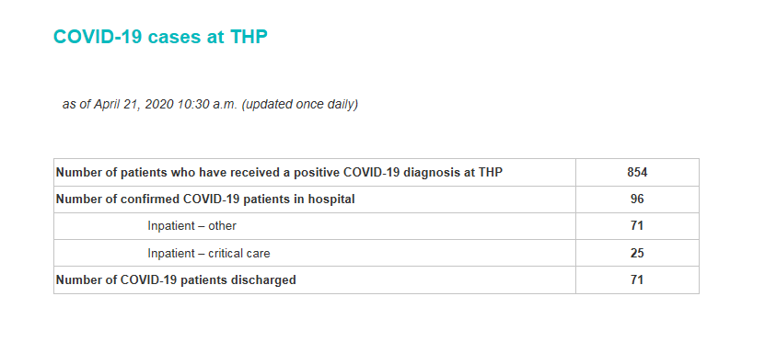
Example: Trillium Health Partners’ Website Update

Slide 28
Example: Outbreak Memo
[insert number of patients/residents and/or health care workers] on [specify unit if applicable] at [insert name of organization/site] have tested positive for COVID-19 between [insert dates]. In consultation with Peel Public Health, we have declared an outbreak. These cases have been acquired from a number of sources, including community and hospital transmissions.
As COVID-19 is prevalent in the community, we are starting to see more staff to staff and hospital transmissions.
It is imperative that in addition to our usual practices, all staff and professional staff adhere to all infection control practices including:
Physical distancing
Appropriate use of personal protective equipment
Hand hygiene
Cleaning of shared equipment
No shared food or eating in unit common spaces
We are implementing the following measures which include, but are not limited to:
[insert steps]
These protocols will be in place for minimum of 7 days then reassessed. If you have questions, please contact [insert contact].

Slide 29
Example: Key Messages for Families Regarding Staff Testing Positive for COVID-19 at a Congregate Living Environment
We want you to be aware that an employee at [insert name of congregate living environment] has tested positive for COVID-19.
At no point did this employee work in the [name of unit], which is a separated from the rest of the facility and has its own entrance. We follow rigorous infection prevention and control protocols.
The employee who tested positive for COVID-19 is currently recovering at home in isolation and has not come into the [insert type of congregate setting] since developing symptoms [insert time frame, e.g. last week].
[insert name of congregate setting] has proactively tested staff and residents who may have been in contact with the healthcare worker. All test results were negative for COVID-19.
Staff and residents continue to be closely monitored for symptoms and we are working closely with the Public Health Unit to trace the healthcare worker’s movement throughout the facility. In an abundance of caution, public health has declared an outbreak at the [insert type of congregate setting, e.g. senior’s home].
Again, we want to assure you that the safety of our residents and staff remains our highest priority. [Insert name of congregate living environment] implemented strict measures early-on in the pandemic to ensure all infection control protocols were in place to contain the spread of COVID-19 and continues to take all precautions necessary, including twice-daily temperature checks for all staff.
We will continue to keep you informed of any further developments. If you have any questions, please don’t hesitate to contact [insert name, title and contact information].

Slide 30
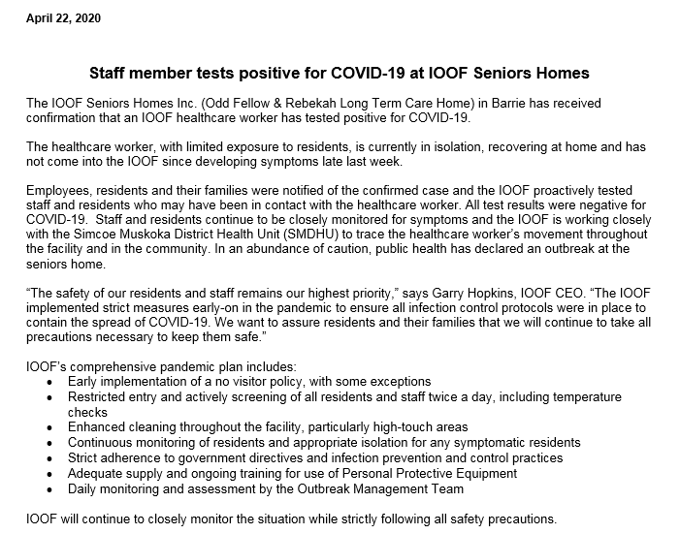
Example: Royal Victoria Regional Health Centre’s News Release Regarding Staff Testing Positive for COVID-19

Slide 31
Example: Trillium Health Partners’ Statement for Website and Social Media regarding first COVID-related patient death

Slide 32
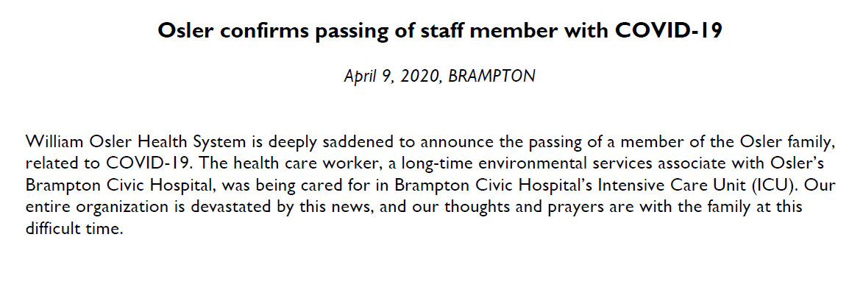
Example: William Osler Health System’s Media Statement Regarding COVID-related Staff Death

Slide 33
Example: Trillium Health Partners’ Media Response Regarding Outbreak
Question:
Your website is reporting 5 outbreaks at specific units at your hospitals, are you able to provide specific numbers for each of these units?
Response:
The current public health guideline for an outbreak is defined as when a unit has two or more patients who test positive for a respiratory illness (e.g. flu), acquired in hospital, within 48 hours. There is currently no formal guideline specific to a COVID-19 outbreak.
In the absence of this, and in consultation with Peel Public Health, we are using a more stringent definition for a COVID-19 outbreak. Specifically we are defining a COVID-19 outbreak as two or more patients and/or staff with confirmed COVID-19 identified within a five day period where there is a reasonable epidemiological link between the cases. We continue to work in partnership with the region and province on a formal definition and will continue to use the above definition in the interim.
Currently, there are five COVID-19 outbreaks that are in effect at THP. Please note that the numbers provided below are from when the respective outbreaks were declared.
Unit 4B Medicine at Mississauga Hospital (outbreak declared on April 9)
Seven health care workers on Unit 4B at Mississauga Hospital tested positive for COVID-19
Unit 3A Medicine at Mississauga Hospital (outbreak declared on April 11)
Three health care workers and a patient on Unit 3A at Mississauga Hospital tested positive for COVID-19
Unit 2D Mental Health at Credit Valley Hospital (outbreak declared on April 12)
Two patients on Unit 2D Mental Health at Credit Valley Hospital tested positive for COVID-19
Unit 1B Medicine at Credit Valley Hospital (outbreak declared on April 14)
Two patients and two health care workers on Unit 1B Medicine at Credit Valley Hospital tested positive for COVID-19
Unit 2B at Credit Valley Hospital (outbreak declared on April 18)
Six health care workers and three patients on Unit 2B at Credit Valley Hospital have tested positive for COVID-19
THP’s top priority is the safety of our patients, people and the community. As we continue to see community spread of COVID-19, the hospital remains vigilant and is actively preparing measures to respond to additional COVID-19 cases and outbreaks. To learn more about the steps THP is taking to respond to COVID-19, please visit www.thp.ca.

Slide 34
General Social Media Tips for Staff
Think twice!
Please make sure you’re posting in the spirit of your organization’s vision, mission and values. A misinterpreted post, like or reply can negatively affect your reputation as well as your organization’s.
Keep patient privacy in mind
Regardless of consent, patients cannot be in your own personal social media feed. If you would like to share a patient story, please contact your organization’s communications team or lead who can advise on appropriate next steps.
You are more known than you think
Your affiliation to the hospital is just a quick search away on Google, LinkedIn or a regulatory college site like CPSO or CNO.
Be mindful of who/what you’re tagging
DO recognize your team - tagging co-workers for a job well done or for sharing ‘kudos’ is a great use of social media.
DON’T tag journalists or politicians – your organization’s communication team or lead should manage this.
Don’t air dirty laundry
Feeling frustrated about an issue or co-worker at work makes us human. Talk to a colleague, your leader or a family member rather than posting work-related frustrations on social media.
Internal documents are meant to be internal
Our internally distributed policies, procedures and clinical guidance documents are not meant for social media conversations. Even posting snippets of these documents can result in misinterpretations.

